Slide 1

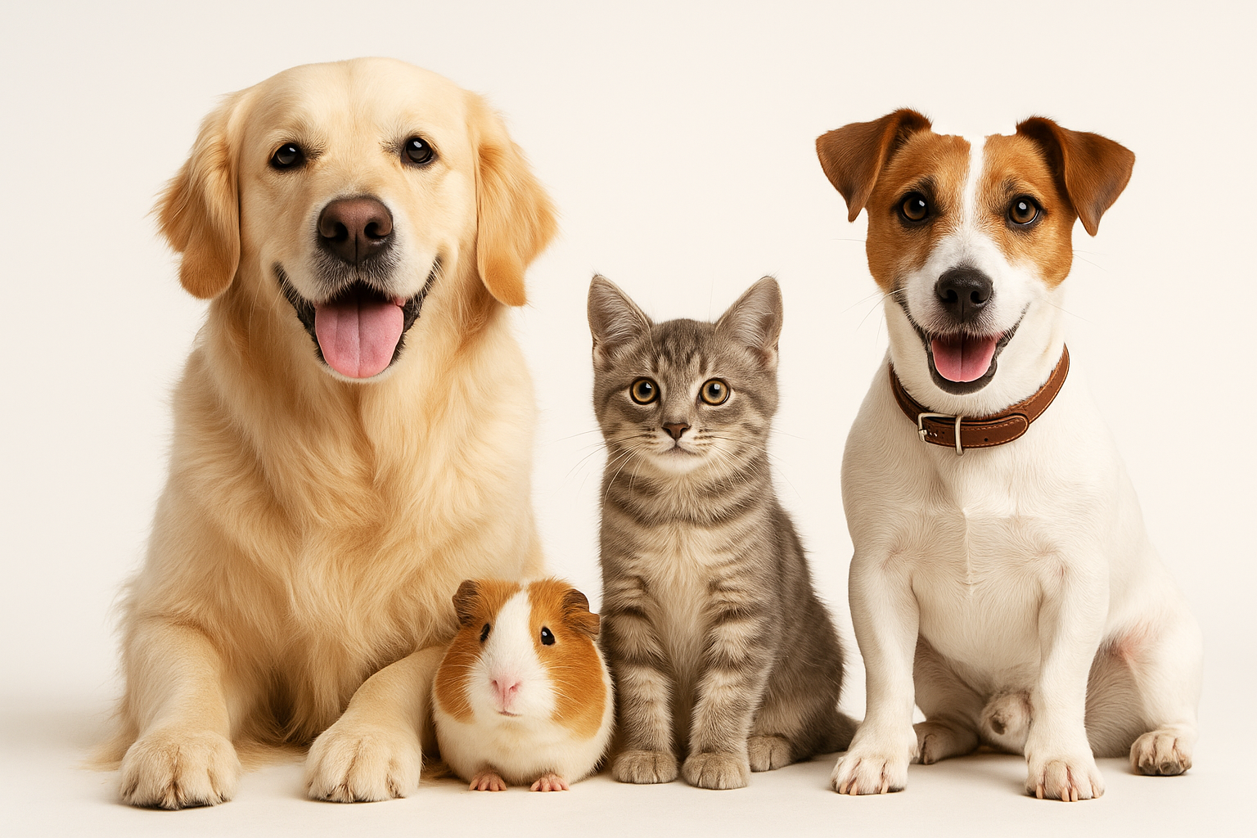
PET CARE
Animal Health and Wellness Application
Presented by:
Sushma Kunjangada Arun
Ravikumar Gangenapura Suresh

Slide 2
Operating Instructions
Launch the application using NetBeans or run the compiled .jar file.
Login Screen: Enter username and password based on your role (Admin, Doctor, Receptionist).
Admin Dashboard:
Manage Pets, Vets, Billing, Inventory, Receptionists, and Appointments.
Receptionist Dashboard:
Register Pets, Book Appointments, and Process Billing.
Doctor Dashboard:
View and Manage Appointments and Pet Medical Records.
All data is stored and retrieved from CSV files.
Exit safely to ensure all file operations are completed.

Slide 3

TEAM MEMBERS & CONTRIBUTIONS
Sushma Kunjangada Arun:
Login Screen, Admin Dashboard, Pets Management, Vets, Billing, Inventory, Receptionists, Appointments.
Ravikumar Gangenapura Suresh:
Receptionist Dashboard, Doctor Dashboard, Pet Registration, Appointment Scheduling, Billing Integration.

Slide 4
OOPS CONCEPTS USED
Encapsulation: Private attributes with getters/setters (e.g., Pet, Appointment).
Abstraction: File operations and CSV handling abstracted in utility/helper classes.
Inheritance: User class inherited by Admin, Doctor, Receptionist.
Polymorphism:
->Overloaded constructors for different User types.
->Method overriding where needed (e.g., manageAppointments())

Slide 5
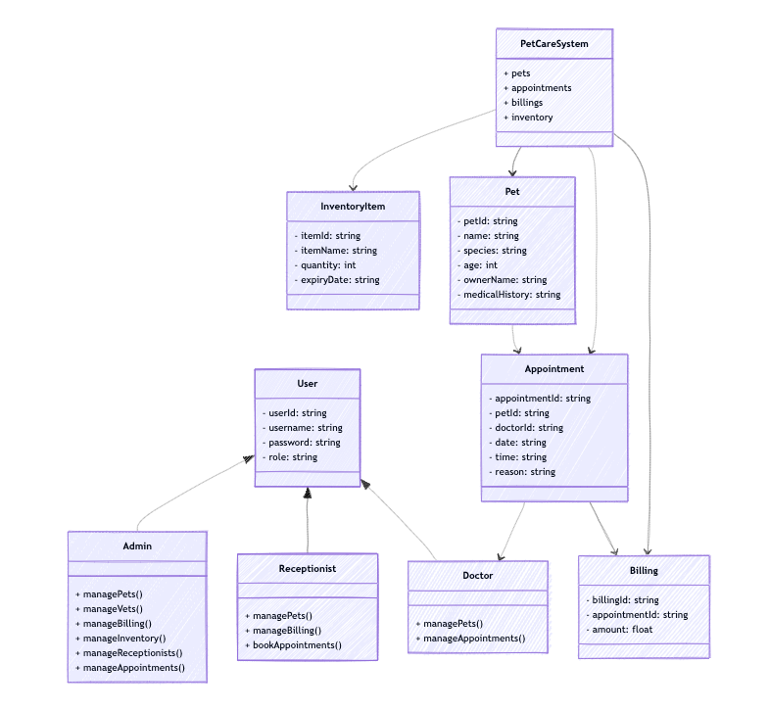
ARCHITECTURE DIAGRAM

Slide 6
TECHNOLOGY AND DESIGN CONCEPTS USED
Technologies:
Java SE (Swing for GUI)
CSV File I/O
NetBeans IDE
GitHub for version control
Design Concepts:
MVC (Model-View-Controller) inspired design for separation of concerns.
Modular Panels for different user roles.
Applied Learning from CSYE6200:
Java OOP Design Patterns.
GUI design using Swing.
Exception Handling.
File I/O operations and data validation.

Slide 7
TECHNOLOGY AND DESIGN CONCEPTS USED
Independent Research:
CSV handling best practices in Java.
UI/UX principles for desktop applications.
Role-based access management in GUI applications.
Third-Party Libraries or Packages Used
None used. All functionality (GUI, file handling, etc.) implemented using Java Standard Library.

Slide 8
FUTURE ENHANCEMENTS
Transition from CSV to SQLite for better data integrity and scalability.
Add Reports/Analytics for appointments, revenue, and inventory trends.
Implement Search and Filter functionality in tables.
Add Email Notifications for appointment reminders.
Improve UI/UX using a more modern JavaFX or Web-based interface.
Introduce User Preferences and settings (themes, currency, etc.).

Slide 9
LESSONS LEARNED
Importance of planning a clear class structure for scalability.
Efficient data handling and validation prevent runtime errors.
Experience with role-based UI management enhanced understanding of access control.
Real-world challenges of UI design and user flow consistency.
Improved team collaboration using GitHub for version control and task management.

Slide 10
THANK YOU

